Slide 1
ASA Presentation
Member Advocacy Checklist

Slide 2
ASA Advocacy Checklist
Partner with a Payer
Press Events
Legislator Tours
Keep America Fishing Buck Slip Distribution
Keep America Fishing Features
Employee Sign-Up Drive
Fundraising
ASA Presentation

Slide 3
Partner with a Payer

Slide 4
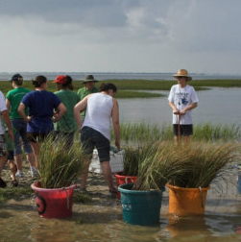
Partner with a Payer
ASA Member Advocacy
Learn How Your Tax Money Is Used
Through the federal excise tax on fishing equipment, ASA members directly contribute to the budgets of the government agencies in charge of fish and wildlife management. Learning more about how those agencies use these funds can build partnerships and a stronger sense of commitment to our nation’s conservation efforts.
ASA Presentation

Slide 5
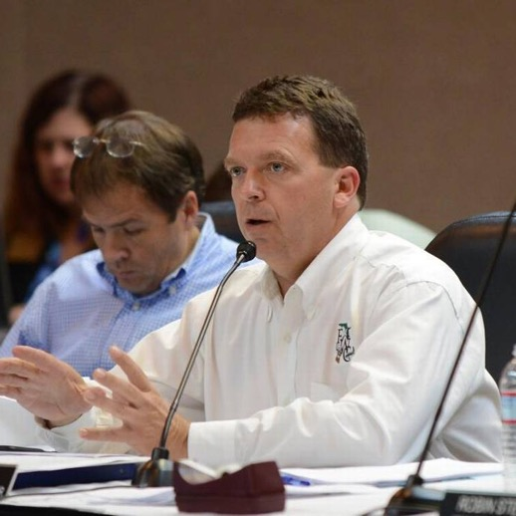
Partner with a Payer
ASA Member Advocacy
What you can do:
Host a meeting with your fish and wildlife agency director and fisheries management staff.
Send a company representative along on an agency’s research or educational initiatives.
Contact ASA vice president and chief marketing officer Liz Ogilvie to help make these connections.
Eric Sutton Executive Director of the Florida Fish and Wildlife Conservation Commission
ASA Presentation

Slide 6
Press Events

Slide 7
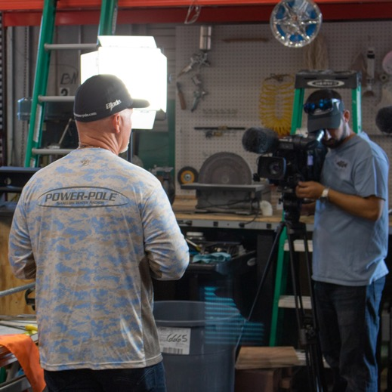
Press Events
ASA Member Advocacy
Spread the Word with Media
Due to ever-shrinking newsrooms and rapidly changing roles in the digital news landscape, getting traditional media coverage for the outdoors industry has become much harder. In order to show journalists and other members of the press how important fishing and boating is to the U.S. economy, you have to take the story to them and show them that the fishing and boating industries aren't just about playtime - we influence millions of Americans. Demonstrating who we are can help get our stories and opinions in mainstream press.
ASA Presentation

Slide 8
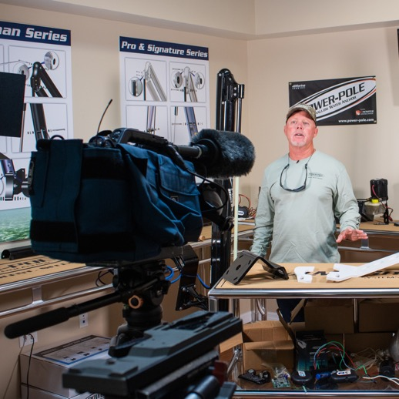
Press Events
ASA Member Advocacy
What you can do:
Host media tours and press days at your facilities
Coordinate product demo and media trips on the water
Directly reach out to media for potential features and stories beyond generic press releases
ASA Presentation

Slide 9
Legislator Tours

Slide 10
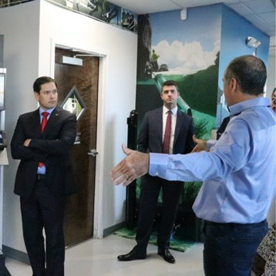
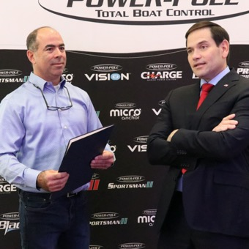
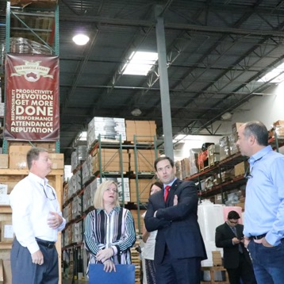
Legislator Tours
ASA Member Advocacy
Host a Lawmaker
Just like the press, legislators often don't realize the impact that the fishing and boating industry has in their local community. Communicating directly with representatives can be an important way to bridge the connection between our policy priorities and their constituents.
ASA Presentation

Slide 11
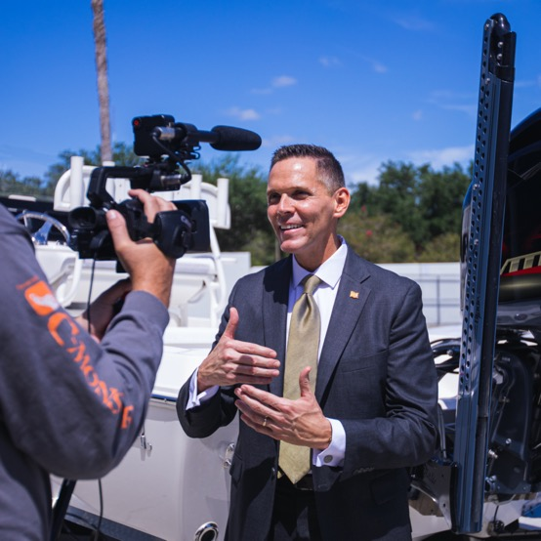
Legislator Tours
ASA Member Advocacy
What you can do:
Host a company tour for elected representatives
Coordinate community Q&A sessions for politicians
Contact ASA’s Government Affairs team to help coordinate
ASA Presentation

Slide 12
Keep America Fishing Buck Slip Distribution

Slide 13
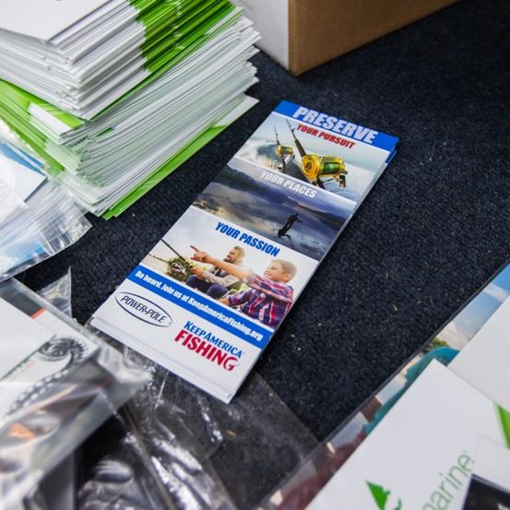
Keep America Fishing Buck Slip Distribution ASA Member Advocacy
Promote Keep America Fishing
Help spread the word about grassroots advocacy and getting involved in our industry's policy priorities through ASA’s Keep America Fishing (KAF) program. Co-branded buck slips can be handed out to customers at point of purchase or anywhere you directly interact with them. By being a conduit of this information, you can demonstrate that you value KAF as a resource and want your customers to join you in these efforts.
ASA Presentation

Slide 14
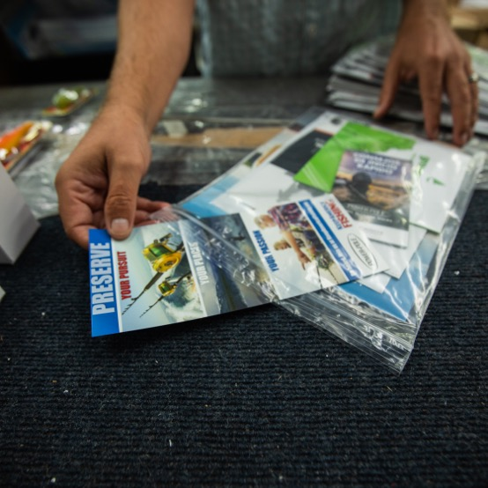
Keep America Fishing Buck Slip Distribution ASA Member Advocacy
What you can do:
Place buck slips and other KAF collateral in shopping bags or product packaging
Distribute collateral alongside other marketing materials at trade shows and other events
Contact ASA vice president and chief marketing officer Liz Ogilvie to get started
ASA Presentation

Slide 15
Keep America Fishing Features

Slide 16
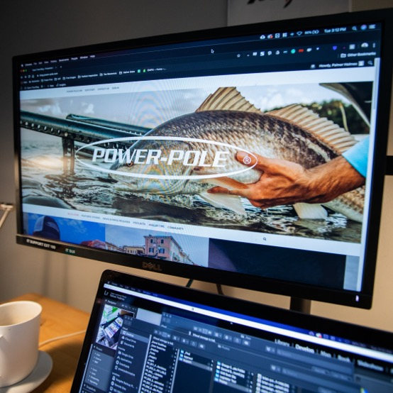
Keep America Fishing Features ASA Member Advocacy
Share Your Own Story
Digital content platforms such as company websites, social media and corporate blogs enable direct communication with your customers. Empower your communications staff, including social media managers, to share ASA and KAF content through these channels and tell your customers how you are involved in the issues facing our industry on their behalf.
ASA Presentation

Slide 17
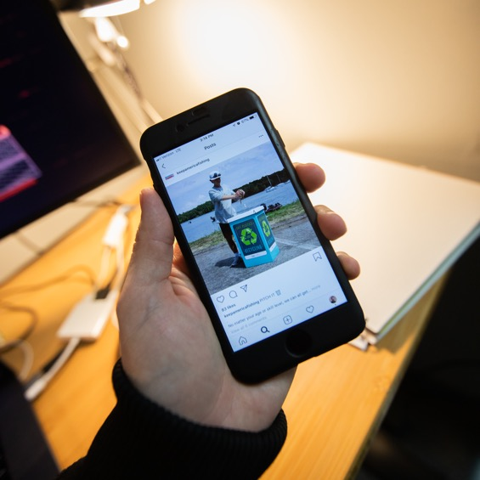
Keep America Fishing Features ASA Member Advocacy
What you can do:
Create co-branded posts for social media or reshare existing posts to amplify their effectiveness
Provide a direct link to Keep America Fishing on your website
Apply ”Keep America Fishing” logo to pro staff jerseys
ASA Presentation

Slide 18
Employee Sign-Up Drive

Slide 19
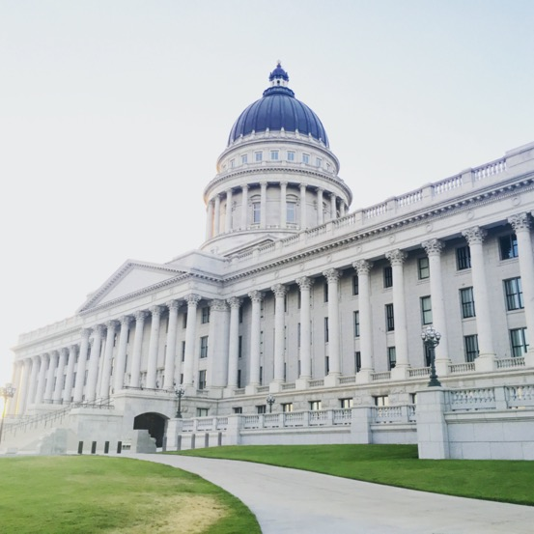
Employee Sign-Up Drive ASA Member Advocacy
Get Employees Involved
Your employees are directly affected by the government relations efforts of ASA so it makes sense that they are the first line of action takers in our advocacy efforts. To keep your business thriving, they should be kept informed of the issues that the industry is currently facing.
ASA Presentation

Slide 20
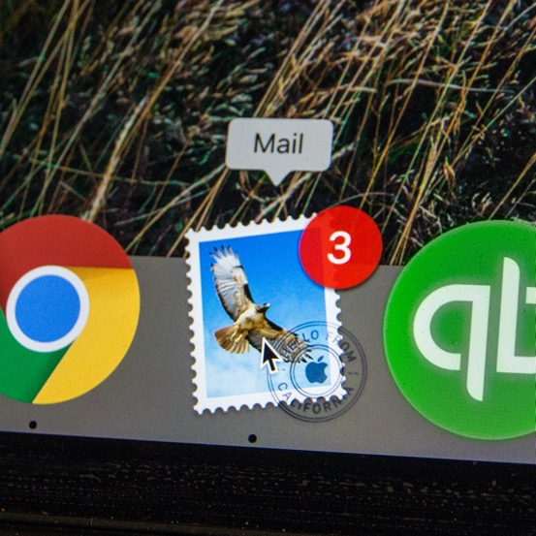
Employee Sign-Up Drive ASA Member Advocacy
What you can do:
Encourage staff to sign up for KAF action alerts and email newsletters at www.KeepAmericaFishing.org
Provide links to ASA news and updates in employee newsletters and intranet
ASA Presentation

Slide 21
Fundraising

Slide 22
Fundraising ASA Member Advocacy
Fundraising for the Cause
One of the easiest ways to support ASA and KAF initiatives is through monetary donations. By tapping into their customer base, companies are able to raise funds to help ASA continue advocating on their behalf.
ASA Presentation

Slide 23
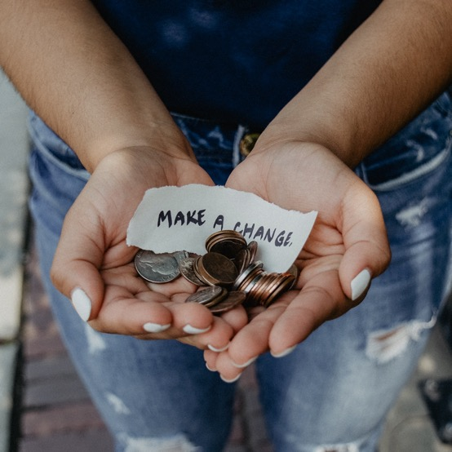
Fundraising ASA Member Advocacy
What you can do:
Purchase-driven donations by a percentage of sales
KAF-branded affiliate donation drives
Registry round-ups during public events
Contact ASA’s vice president and chief marketing officer Liz Ogilvie to coordinate an agreement
ASA Presentation

Slide 24
Thank You

